Slide 1
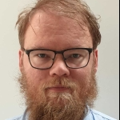
Paderborn Photonic Lecture
Mittwoch, 18th May 2022 | 15:30 h
Dr. J. REnema
Lecture Hall A.1
Integrated photonic quantum information processing
Quantum photonics is one of the leading approaches to large-scale quantum computing, being one of two technology platforms that has demonstrated a quantum advantage. Integrated optics is a scalable way of creating the large-scale optical systems necessary for quantum photonics. In this talk, I will present an overview of our efforts on integrated photonic QIP, including the recent quantum advantage experiments, the world's largest quantum photonic processor, and an experiment on quantum-photo-thermodynamics.
Dr. J.J. Renema
Universiteit Twente / Quix Quantum BV
F

